Slide 1
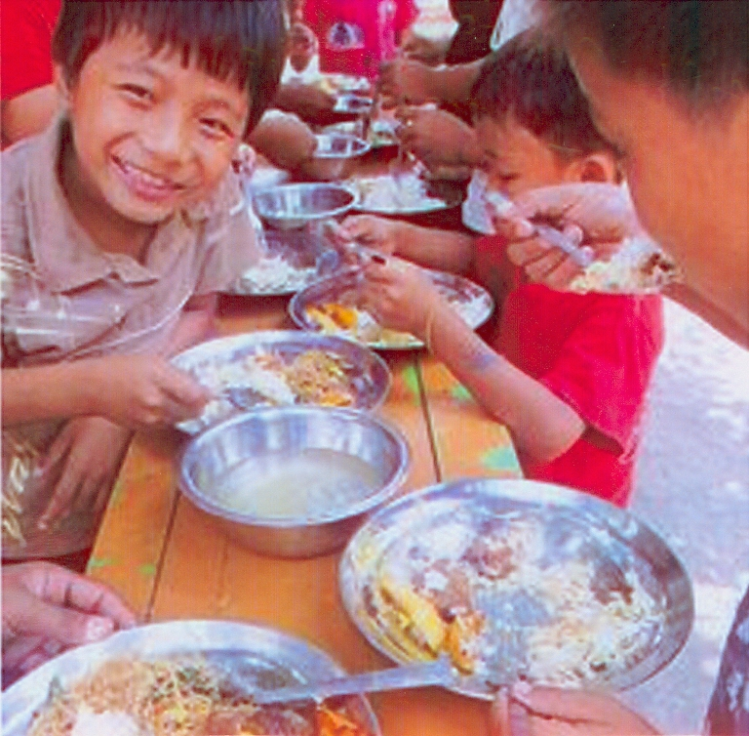
Mid Day Meal
in
Nagaland

Slide 2
- Activities Undertaken in 2017-18 -
Capacity Building & Sensitization done at all levels –
IEC activities taken up - Flexi Banners of MDMS put up in all blocks
100% e-transfer of fund done till the school level
45% e-transfer of honorarium done for CCHs
Rationalization of schools completed, 152 Middle & Primary schools merged, 18 Middle schools downgraded & 9 Primary schools closed down.
Monitoring strengthened by setting up a Monitoring & Supervision Cell
Monitoring further strengthened by appointment of 134 Area Education Officers to monitor & inspect 15 schools at an average per officer.

Slide 3
- Proposed Activities in 2018-19 -
Conduct sample social Audits in all districts of the state
Channelize efforts on encouraging more community participation – probability of a boost in local economy
Engage 3rd Party for Assessment of the Scheme
IEC Plan to be initiated
Conduct re-orientation programmes for stake holders
Strengthen convergence with line departments like H&FW, PHE, Social Welfare etc.
Strengthen Monitoring of the scheme by utilizing the AEOs.

Slide 4
- Requirement of Store-cum-Kitchen -
Kitchen-cum-Stores, an immediate requirement!
1777 facilities constructed during 2006-07 @ Rs. 60,000/facility with locally available resources
Most of the kitchens in dilapidated conditions or non-existent.
Storage of food items a problem in such conditions and bound to be unsuitable for consumption if kept even for some days
Only around 500 store-cum-kitchens constructed in phases using RCC materials
The state proposes construction of 845 kitchen-cum-stores with an estimated cost of Rs. 8516.54 Lakhs during the year – a separate proposal submitted.

Slide 5
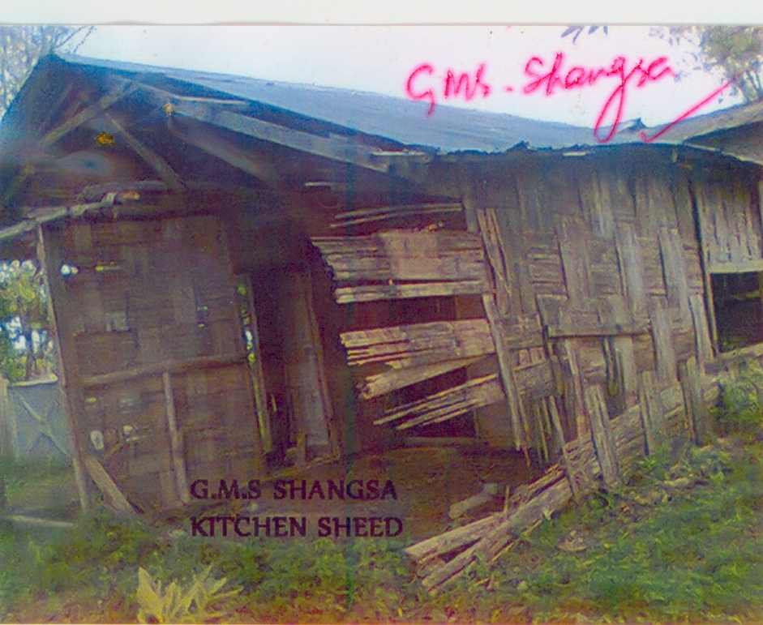
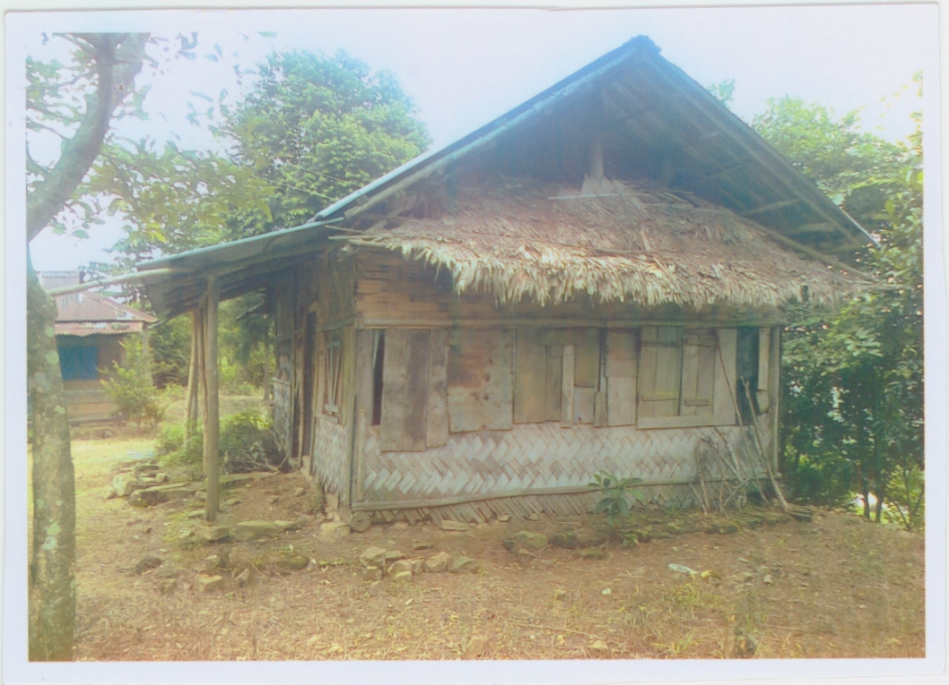
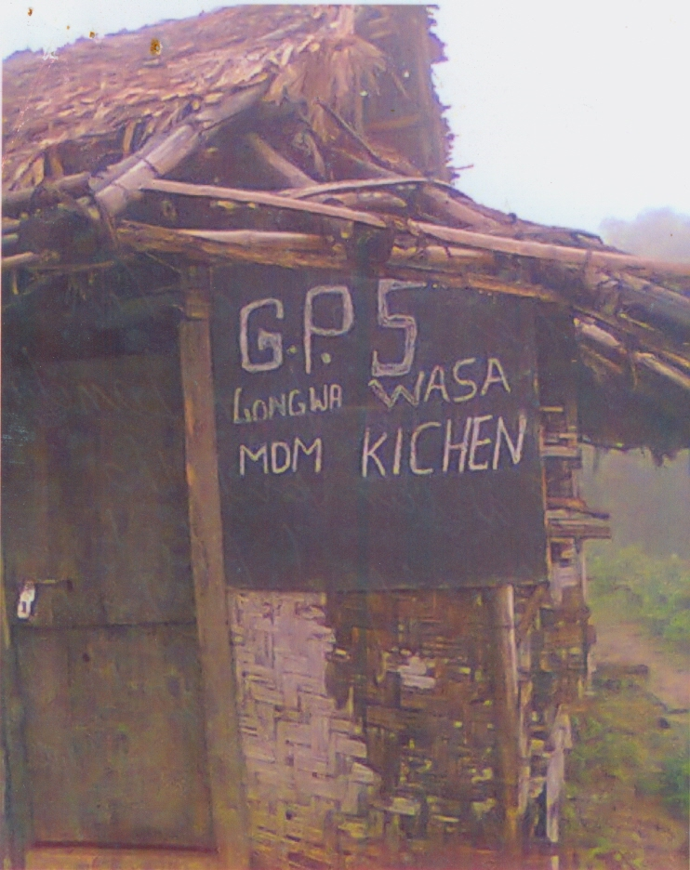
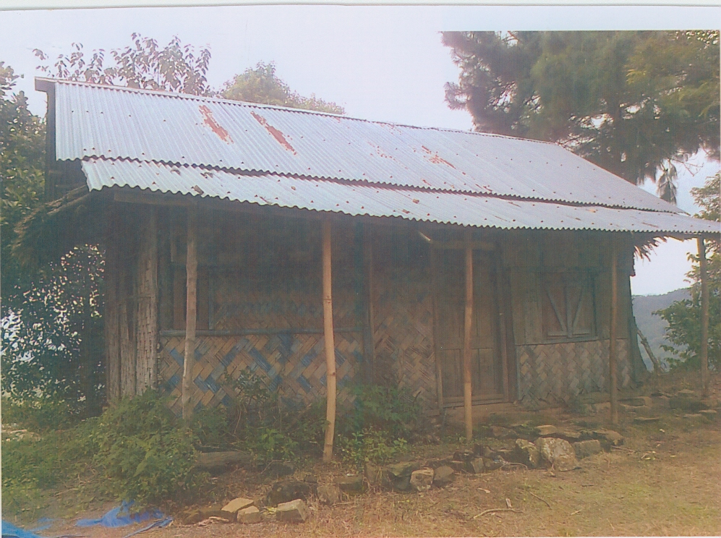
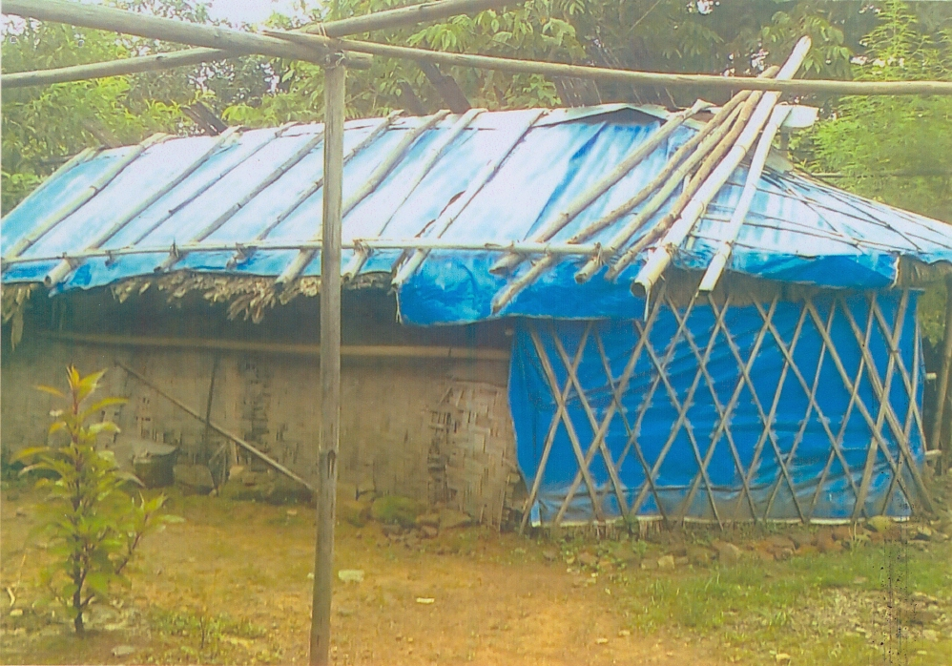
- Requirement of Store-cum-Kitchen -

Slide 6
- Other Issues -
Enhancement in Cooking cost:
Cooking costs @ Rs. 4.15 ps & Rs. 6.21 ps for Primary and Upper-Primary sectors insufficient to provide wholesome meals
An “egg as an attraction” costs Rs. 7/- in the state even at whole sale rates owing to the isolation of the state from the mainland
Enhancement in Cook Honorarium:
Retention of trained & dependable cooks is an issue due to the meagre honorarium & trainings cannot be imparted every time they are replaced.
PAB Approval as per Enrolment and not as per Coverage:
The coverage of students being dynamic, scaling it down as per coverage will adversely impact the scheme since every student opts for MDM & therefore request for fund allocation as per enrolment.

Slide 7
- Other Issues -
Enhancement in MME Fund Allocation:
Employing capable personnel for smooth functioning deliberately overlooked owing to insufficient fund allocation under MME.
Important activities like monitoring, training etc., cannot be done as expected or desired due to fund constraints under MME

Slide 8
PPP – A Success Story!

Slide 9
Thank you

